Slide 1
Lecture # 08 Pipelining Architecture
Parallel and Distributed Computing
CS-482

Slide 2
Introduction to Pipelining
Definition: Pipelining is a technique in computer architecture where multiple instruction stages are overlapped in execution to improve performance.
Need for Pipelining:
Enhances CPU efficiency
Increases instruction throughput
Reduces execution time

Slide 3
What is Pipelining?
Pipelining is a technique used in computer architecture where multiple instruction stages are executed in parallel, improving CPU performance. It divides the execution process into several stages, with each stage handling a different instruction simultaneously. This increases instruction throughput and allows the CPU to process multiple instructions at different stages in a single clock cycle.

Slide 4
Need for Pipelining
Pipelining is essential in modern processors for several reasons:
Improved Performance & Speed
Without pipelining, the CPU executes one instruction at a time, leading to underutilization of processing units.
With pipelining, multiple instructions are processed simultaneously, increasing instruction throughput.
Efficient Resource Utilization
Pipelining ensures that different functional units (fetch, decode, execute, etc.) work in parallel, reducing idle time.
Higher CPU Clock Speeds
Since each instruction is broken into smaller tasks, they can be executed faster, allowing for higher clock frequencies.
Minimizing Instruction Execution Delay
Without pipelining, each instruction must complete before the next begins. Pipelining overlaps execution, reducing overall execution time.
Scalability for Complex Architectures
Advanced architectures like RISC (Reduced Instruction Set Computing) heavily depend on pipelining for optimal performance.
Better Utilization of Multi-Core and Superscalar Architectures
Modern CPUs use multiple execution units. Pipelining helps manage multiple instruction flows efficiently.

Slide 5
Types of Pipelining
Hardware Pipelining: Uses physical components to implement multiple execution stages.
Software Pipelining: Compiler optimizations to rearrange instructions for better performance.

Slide 6
1. Hardware Pipelining (Processor-Level Pipelining)
Hardware pipelining refers to the physical design of a processor where different hardware units are dedicated to specific pipeline stages. It improves execution efficiency by enabling parallel processing of instructions.
Types of Hardware Pipelining:
Instruction Pipelining
Used in CPUs to execute multiple instructions simultaneously by breaking them into different stages (Fetch, Decode, Execute, Memory Access, Write Back).
Example: The 5-stage pipeline in RISC processors.
Arithmetic Pipelining
Used in ALUs (Arithmetic Logic Units) for executing complex mathematical operations like floating-point addition and multiplication.
Example: Floating-Point Unit (FPU) pipelining in modern processors.
Data Pipelining
Used in memory systems to transfer data efficiently between components (cache, main memory, I/O devices).
Example: DMA (Direct Memory Access) controllers use data pipelining.

Slide 7
2. Software Pipelining
Software pipelining is a compiler optimization technique where loops are rearranged to allow parallel execution of instructions. It enhances performance without requiring additional hardware modifications.
Types of Software Pipelining:
Loop Unrolling
Increases instruction-level parallelism by reducing loop control overhead.
Example: Instead of running a loop 10 times, it executes 2 iterations per cycle (5 cycles in total).
VLIW (Very Long Instruction Word) Pipelining
Compilers schedule multiple operations into a single instruction word, executed in parallel.
Example: Used in DSP (Digital Signal Processing) processors.
Speculative Execution
Instructions are executed before their conditions are confirmed, reducing pipeline stalls.
Example: Used in branch prediction to reduce control hazards.
Software Parallelism in Multi-Core Processors
Breaking tasks into multiple threads to utilize multiple cores effectively.
Example: OpenMP and CUDA-based parallel programming.

Slide 8
Tradeoff Between Cost and Performance in Pipelining
Pipelining improves system performance by increasing instruction throughput, but it also introduces higher costs due to hardware complexity, power consumption, and design challenges. The tradeoff between cost and performance must be carefully balanced depending on the application and system requirements.

Slide 9
Tradeoff Between Cost and Performance in Pipelining
Scenario | High Performance | Low Cost
Simple CPU Design (e.g., embedded systems) | Few pipeline stages, lower complexity | Reduced hardware cost, lower power usage
High-Speed Processors (e.g., gaming, AI, HPC) | Deep pipelining, out-of-order execution | Expensive fabrication and higher power
Superpipelining (More stages per instruction) | Increases clock speed and performance | Increases hazard handling complexity
Superscalar (Multiple pipelines) | Can execute multiple instructions per cycle | Requires more execution units, raising cost
Software Pipelining Optimization | Compiler-based optimization for performance | No extra hardware cost but adds complexity

Slide 10
Optimizing the Tradeoff
To balance cost and performance:
Select the right pipeline depth – Avoid excessive stages that increase hazards.
Use hazard mitigation techniques – Register forwarding and branch prediction improve efficiency.
Optimize instruction scheduling – Software pipelining can reduce hardware complexity.
Choose the right architecture – RISC favors deeper pipelines, while CISC may avoid excessive pipelining.
For cost-sensitive applications (e.g., embedded systems, IoT), simpler pipelines with fewer stages are preferable.
For performance-critical applications (e.g., gaming, AI, supercomputing), deeper pipelines with advanced hazard handling are necessary, despite higher costs.
The ideal balance depends on system requirements, workload, and power constraints.

Slide 11
Stages in Pipelining
Instruction Fetch (IF): Fetch the instruction from memory.
Instruction Decode (ID): Decode the instruction and determine operands.
Execute (EX): Perform the operation.
Memory Access (MEM): Read/write data from/to memory.
Write Back (WB): Store the result in a register.

Slide 12
1. Instruction Fetch (IF)
Retrieves the next instruction from memory (RAM or cache).
Updates the Program Counter (PC) to point to the next instruction.
Possible Issue: Branch instructions may cause incorrect instruction fetching (Control Hazard).
Optimization Techniques:
Instruction Prefetching: Fetches multiple instructions in advance.
Branch Prediction: Predicts the outcome of branch instructions to avoid stalls.

Slide 13
2. Instruction Decode (ID)
Decodes the fetched instruction to determine the operation type (arithmetic, load/store, branch, etc.).
Identifies source registers and operands.
Sends control signals to the execution unit.
Optimization Techniques:
Register Renaming: Resolves data dependency issues.
Out-of-Order Execution: Allows instructions to execute in a different order for efficiency.

Slide 14
3. Execute (EX)
Performs the actual computation or operation using the ALU (Arithmetic Logic Unit).
If it’s an arithmetic instruction, the ALU performs the calculation.
If it’s a branch instruction, branch target addresses are calculated.
Optimization Techniques:
Operand Forwarding: Bypasses unnecessary waiting by sending results directly to the next stage.
Multiple Execution Units: Allows parallel processing of instructions.

Slide 15
4. Memory Access (MEM)
Accesses memory for load/store instructions.
Load Instruction (LW): Reads data from memory into a register.
Store Instruction (SW): Writes register data into memory.
Optimization Techniques:
Cache Memory: Reduces memory access delays.
Memory Hierarchy Optimization: Uses multi-level caching (L1, L2, L3).

Slide 16
5. Write Back (WB)
Stores the result of execution (ALU result or memory read) into the destination register.
Ensures data is available for future instructions.
Optimization Techniques:
Register Forwarding: Reduces waiting by immediately using updated register values.
Write Buffers: Improves memory write performance.

Slide 17
Graphical Representation of Pipelining
Stage / Segment
Interface Register
Output
Input
S1
S2
S3
Sn
Clock

Slide 18
Example of Instruction Execution in Pipelining
Assume we have three instructions:
1. ADD R1, R2, R3
2. SUB R4, R5, R6
3. LOAD R7, 0(R8)

Slide 19
In a pipelined processor, execution happens as follows:
Cycle | IF (Fetch) | ID (Decode) | EX (Execute) | MEM (Memory) | WB (Write Back)
1 | ADD
2 | SUB | ADD
3 | LOAD | SUB | ADD
4 | Next Inst | LOAD | SUB | ADD
5 | ... | Next Inst | LOAD | SUB | ADD
6 | ... | ... | Next Inst | LOAD | SUB

Slide 20
Example of Instruction Execution in Pipelining
Instead of executing one instruction at a time, multiple instructions are overlapping in execution.
This improves throughput significantly compared to non-pipelined execution.
The five-stage pipeline (IF, ID, EX, MEM, WB) is widely used in RISC architectures like MIPS. More complex architectures (e.g., Intel, AMD CPUs) may have deeper pipelines (10+ stages) for higher performance, but they must handle hazards and stalls efficiently.

Slide 21
Pipeline Execution Diagram(space time Diagram)
Clock Cycle → | 1 | 2 | 3 | 4 | 5 | 6 | 7 | 8 | 9
Instr 1 | IF | ID | EX | MEM | WB
Instr 2 |  | IF | ID | EX | MEM | WB
Instr 3 |  |  | IF | ID | EX | MEM | WB
Instr 4 |  |  |  | IF | ID | EX | MEM | WB
Instr 5 |  |  |  |  | IF | ID | EX | MEM | WB

Slide 22
Serial Execution (Without Pipelining)
Clock Cycle → | 1 | 2 | 3 | 4 | 5 | 6 | 7 | 8 | 9 | 10 | 11 | 12 | 13 | 14 | 15
Instr 1 | IF | ID | EX | MEM | WB
Instr 2 |  |  |  |  | IF | ID | EX | MEM | WB
Instr 3 |  |  |  |  |  |  | IF | ID | EX | MEM | WB
Instr 4 |  |  |  |  |  |  |  |  | IF | ID | EX | MEM | WB
Instr 5 |  |  |  |  |  |  |  |  |  |  | IF | ID | EX | MEM | WB

Slide 23
Pipelined vs Non-Pipelined Execution
Total Cycles Required for 15 Instructions in Serial Execution: 75 Cycles (Each instruction takes 5 cycles, executed sequentially)
Total Cycles for 15 Instructions in Pipelined Execution: 19 Cycles (Only the first instruction takes 5 cycles, then a new instruction enters every cycle)

Slide 24
Pipelined vs Non-Pipelined Execution
Feature | Pipelined Execution | Non-Pipelined Execution
Instruction Execution | Overlapped | Sequential
Speedup | High | Low
Efficiency | High | Low
Utilization | Better resource utilization | Poor resource utilization

Slide 25
Characteristics of Pipelining
Multiple Instructions Executed Simultaneously: Pipelining allows multiple instructions to be in different execution stages at the same time, improving CPU throughput.
Segmentation of the Instruction Cycle: The instruction cycle is divided into distinct stages (e.g., Fetch, Decode, Execute, Memory, Write Back). Each stage performs a specific task.
Overlapping of Operations: Different instructions are processed in different pipeline stages simultaneously, leading to efficient utilization of CPU resources.
Increased Throughput: The number of instructions completed per unit time is higher compared to non-pipelined execution.
Reduced Execution Time: Once the pipeline is full, an instruction is completed in nearly every cycle, reducing the average execution time per instruction.

Slide 26
Characteristics of Pipelining
Pipeline Depth (Stages Count): The number of stages in a pipeline determines the depth of pipelining. More stages generally improve throughput but may increase complexity.
Pipeline Hazards: Pipelining can face structural hazards (resource conflicts), data hazards (data dependencies), and control hazards (branch instructions).
Speedup Factor: Ideally, a pipeline can achieve a speedup equal to the number of stages, but practical speedup is limited due to stalls and hazards.
Dependency Management: Modern processors include techniques like forwarding and branch prediction to handle dependencies and improve pipeline efficiency.
Latency vs. Throughput Trade-off: While pipelining improves instruction throughput, it does not reduce the execution time of a single instruction (latency remains the same).

Slide 27
Example: 8 Instructions in a 5-Stage Pipeline
We consider a 5-stage RISC pipeline with the following stages:
IF (Instruction Fetch) – Fetch instruction from memory.
ID (Instruction Decode) – Decode instruction & read registers.
EX (Execute) – Perform ALU operation.
MEM (Memory Access) – Read/write memory (for load/store).
WB (Write Back) – Write results to registers.

Slide 28
Instructions in the Program
LOAD R1, 0(R2) – Load value from memory to R1
ADD R3, R1, R4 – Add R1 and R4, store in R3
SUB R5, R3, R6 – Subtract R6 from R3, store in R5
MUL R7, R5, R8 – Multiply R5 and R8, store in R7
AND R9, R7, R10 – Bitwise AND on R7 and R10, store in R9
OR R11, R9, R12 – Bitwise OR on R9 and R12, store in R11
XOR R16, R11, R14 – XOR operation, store in R16
STORE R16, 0(R15) – Store R16 into memory

Slide 29
Pipeline Execution Table (Clock Cycles)
Clock Cycle → | 1 | 2 | 3 | 4 | 5 | 6 | 7 | 8 | 9 | 10 | 11 | 12
LOAD R1 | IF | ID | EX | MEM | WB
ADD R3 |  | IF | ID | EX | MEM | WB
SUB R5 |  |  | IF | ID | EX | MEM | WB
MUL R7 |  |  |  | IF | ID | EX | MEM | WB
AND R9 |  |  |  |  | IF | ID | EX | MEM | WB
OR R11 |  |  |  |  |  | IF | ID | EX | MEM | WB
XOR R16 |  |  |  |  |  |  | IF | ID | EX | MEM | WB
STORE R16 |  |  |  |  |  |  |  | IF | ID | EX | MEM | WB

Slide 30
Observations
Instruction Overlap: Each instruction starts before the previous one finishes, improving efficiency.
Speedup Factor: Instead of taking 8 × 5 = 40 cycles in a serial execution, pipelining completes all 8 instructions in 12 cycles.
Hazards & Dependencies: If dependencies exist (e.g., ADD R3, R1, R4 depends on LOAD R1), stalls or forwarding techniques are needed to avoid incorrect results.

Slide 31
Space-Time Diagram
A Space-Time Diagram represents how instructions progress through the pipeline over clock cycles.
Clock Cycle → | 1 | 2 | 3 | 4 | 5 | 6 | 7 | 8 | 9 | 10 | 11 | 12
LOAD R1 | IF | ID | EX | MEM | WB
ADD R3 |  | IF | ID | EX | MEM | WB
SUB R5 |  |  | IF | ID | EX | MEM | WB
MUL R7 |  |  |  | IF | ID | EX | MEM | WB
AND R9 |  |  |  |  | IF | ID | EX | MEM | WB
OR R11 |  |  |  |  |  | IF | ID | EX | MEM | WB
XOR R16 |  |  |  |  |  |  | IF | ID | EX | MEM | WB
STORE R16 |  |  |  |  |  |  |  | IF | ID | EX | MEM | WB

Slide 32
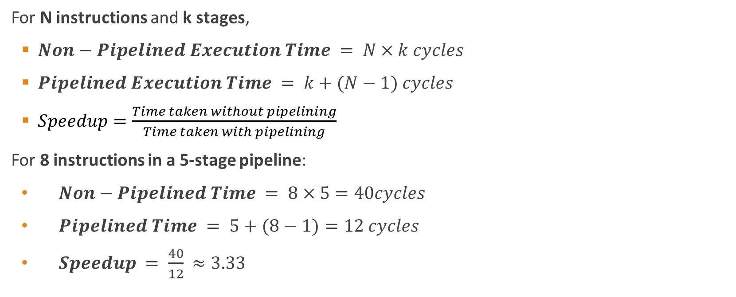
Speedup Calculation
For N instructions and k stages,
$Non−Pipelined Execution Time = N×k cycles$
$Pipelined Execution Time = k+(N−1) cycles$
$Speedup=\frac{Time taken without pipelining}{Time taken with pipelining}$
For 8 instructions in a 5-stage pipeline:
$Non−Pipelined Time = 8×5=40cycles$
$Pipelined Time = 5+(8−1)=12 cycles$
$Speedup = \frac{40}{12}​≈3.33$

Slide 33
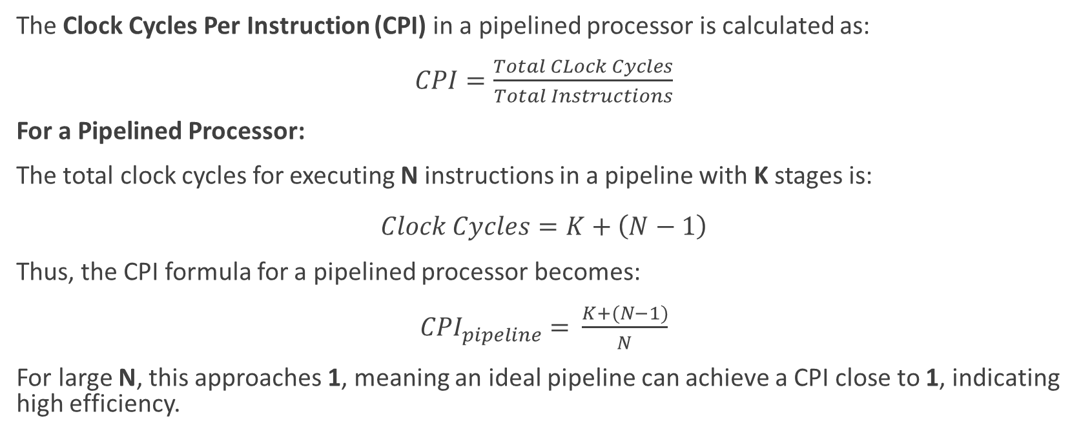
Clock Cycles Per Instruction (CPI)
The Clock Cycles Per Instruction (CPI) in a pipelined processor is calculated as:
$CPI=\frac{Total CLock Cycles}{Total Instructions}$
For a Pipelined Processor:
The total clock cycles for executing N instructions in a pipeline with K stages is:
$Clock Cycles=K+\left(N−1\right)$
Thus, the CPI formula for a pipelined processor becomes:
${CPI}_{pipeline}​=​\frac{K+(N−1)}{N}$
For large N, this approaches 1, meaning an ideal pipeline can achieve a CPI close to 1, indicating high efficiency.

Slide 34
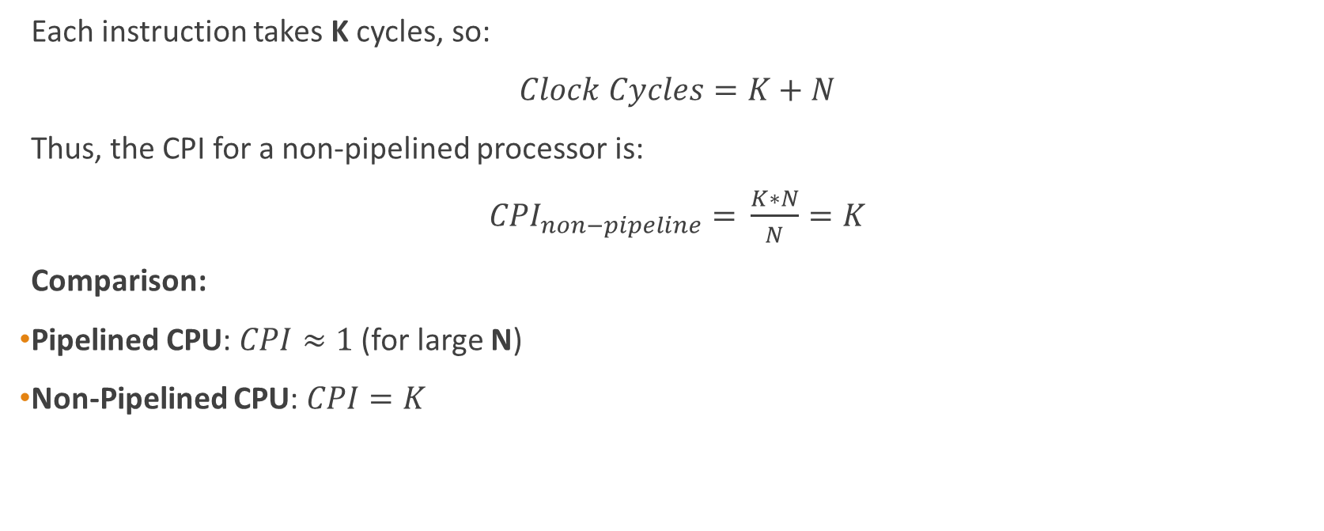
For a Non-Pipelined Processor:
Each instruction takes K cycles, so:
$Clock Cycles=K+N$
Thus, the CPI for a non-pipelined processor is:
${CPI}_{non−pipeline}​=​\frac{K∗N}{N}=K$
Comparison:
Pipelined CPU: $CPI≈1$(for large N)
Non-Pipelined CPU: $CPI=K$

Slide 35
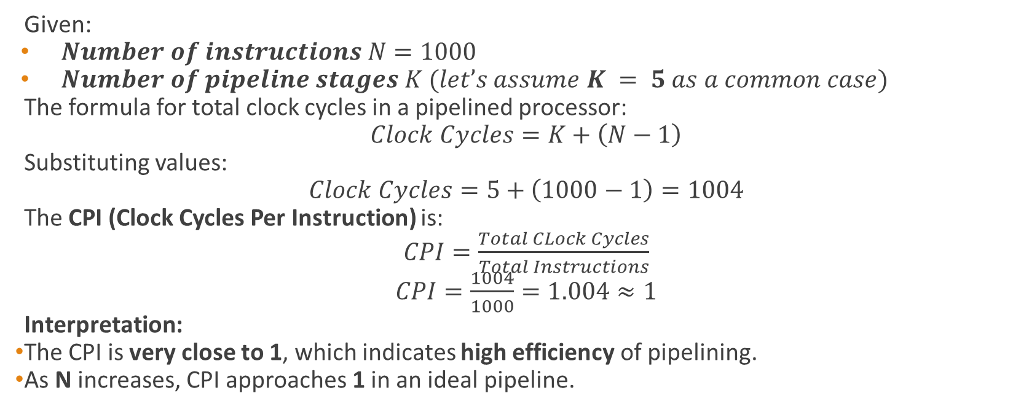
Example
Given:
$Number of instructions N=1000$
$Number of pipeline stages K (let’s assume K = 5 as a common case)$
The formula for total clock cycles in a pipelined processor:
$Clock Cycles=K+\left(N−1\right)$
Substituting values:
$Clock Cycles=5+\left(1000−1\right)=1004$
The CPI (Clock Cycles Per Instruction) is:
$CPI=\frac{Total CLock Cycles}{Total Instructions}$
$CPI=\frac{1004}{1000}=1.004≈1$
Interpretation:
The CPI is very close to 1, which indicates high efficiency of pipelining.
As N increases, CPI approaches 1 in an ideal pipeline.

Slide 36
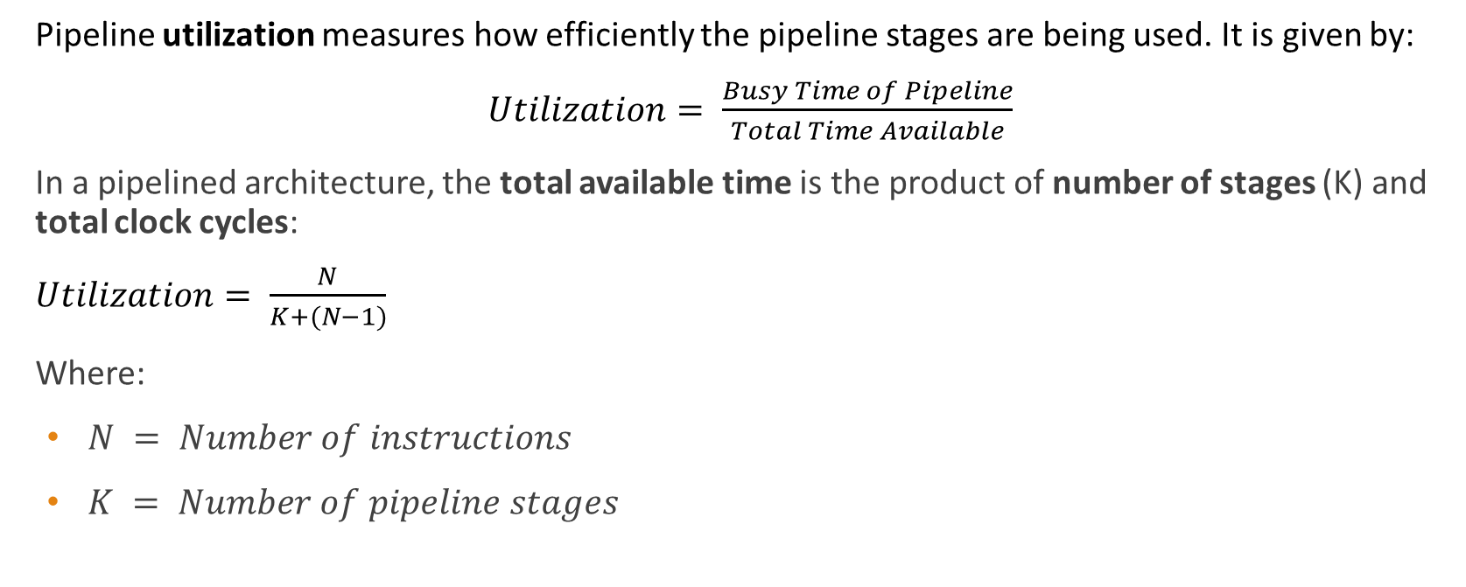
Utilization Formula
Pipeline utilization measures how efficiently the pipeline stages are being used. It is given by:
$Utilization= \frac{Busy Time of Pipeline}{Total Time Available}$
In a pipelined architecture, the total available time is the product of number of stages (K) and total clock cycles:
$Utilization= \frac{N}{K+(N−1)}$
Where:
$N = Number of instructions$
$K = Number of pipeline stages$

Slide 37
Pipeline Execution Diagram(space time Diagram)
Clock Cycle → | 1 | 2 | 3 | 4 | 5 | 6 | 7 | 8 | 9
Instr 1 | IF | ID | EX | MEM | WB
Instr 2 |  | IF | ID | EX | MEM | WB
Instr 3 |  |  | IF | ID | EX | MEM | WB
Instr 4 |  |  |  | IF | ID | EX | MEM | WB
Instr 5 |  |  |  |  | IF | ID | EX | MEM | WB

Slide 38
Serial Execution (Without Pipelining)
Clock Cycle → | 1 | 2 | 3 | 4 | 5 | 6 | 7 | 8 | 9 | 10 | 11 | 12 | 13 | 14 | 15 | 16 | 17 | 18 | 19 | 20 | 21
Instr 1 | IF | ID | EX | MEM | WB
Instr 2 |  |  |  |  | IF | ID | EX | MEM | WB
Instr 3 |  |  |  |  |  |  |  |  | IF | ID | EX | MEM | WB
Instr 4 |  |  |  |  |  |  |  |  |  |  |  |  | IF | ID | EX | MEM | WB
Instr 5 |  |  |  |  |  |  |  |  |  |  |  |  |  |  |  |  | IF | ID | EX | MEM | WB

Slide 39

Example Calculation:
Let’s assume:
$N=1000 instructions$
$K=5 pipeline stages$
Using the formula:
$$Utilization= \frac{N}{K+(N−1)}$$
$$Utilization= \frac{1000}{1000+(5−1)}$$

Slide 40
Numerical
A 5-stage pipeline system consists of the following processing delays at each stage:
Stage 1 (S1) Delay: 180 ns
Stage 2 (S2) Delay: 140 ns
Stage 3 (S3) Delay: 170 ns
Stage 4 (S4) Delay: 130 ns
Stage 5 (S5) Delay: 160 ns
Registers are placed between each stage to store intermediate results, with each register introducing a delay of 8 ns. The system operates with a constant clock cycle determined by the slowest stage plus the register delay.

Slide 41
Questions:
Determine the clock cycle time for this pipeline.
Calculate the total time required to process 1200 data items using the pipeline.
Compare this with the non-pipelined execution time, assuming all stages execute sequentially for each instruction.
Compute the speedup factor of pipelining over non-pipelining.

Slide 42
Problem
A processor operates at a frequency of 3 GHz and takes 5 clock cycles per instruction on average. The system is upgraded to a 6-stage pipelined processor, but due to internal pipeline overheads, the clock speed is reduced to 2.5 GHz. Assume ideal pipelining with no stalls.
Question:
What is the speedup achieved with the pipelined processor?

Slide 43
Hazards in Pipelining
Data Hazards: Dependency between instructions.
Structural Hazards: Limited hardware resources.
Control Hazards: Branch instructions affecting execution flow.

Slide 44
Data Hazards and Types
Read After Write (RAW): Instruction depends on previous instruction result.
Write After Read (WAR): Later instruction writes before an earlier instruction reads.
Write After Write (WAW): Two instructions write to the same register in the wrong order.

Slide 45
Structural Hazards
Occurs when hardware resources are limited (e.g., single memory unit for instruction and data fetch).
Solutions:
Increase hardware units
Instruction scheduling

Slide 46
Control Hazards
Caused by branch instructions affecting the instruction flow.
Solutions:
Branch Prediction
Delay Slots
Speculative Execution

Slide 47
Register Renaming for Data Hazard Resolution
Register Renaming is a technique used to eliminate data hazards (RAW, WAR, and WAW) in pipelining by assigning different physical registers to the same logical register.
This helps avoid conflicts between instructions trying to read or write to the same register.
Commonly used in modern processors that support out-of-order execution and superscalar architectures.

Slide 48
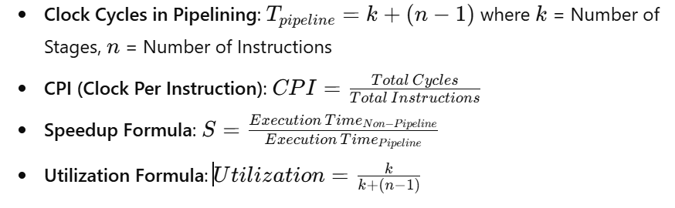
Formulas in Pipelining

